Slide 1

SALARY PREDICTION
of data professions

Slide 2


PROBLEM STATEMENT
Highlight the variability in salaries based on experience, job role, and performance.
Importance of accurate salary predictions for job seekers and employers.

Slide 3
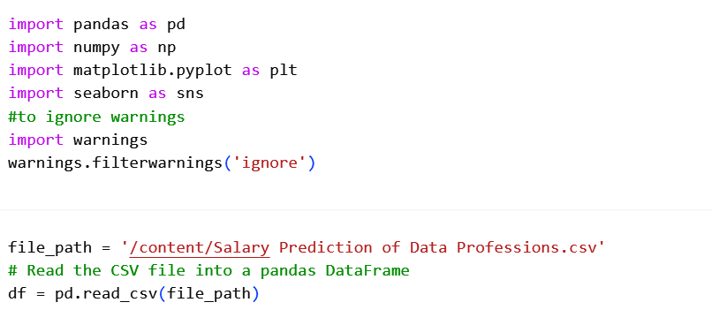



Step 1: Exploratory Data Analysis (EDA)
Import Python Libraries
Read CSV file

Slide 4
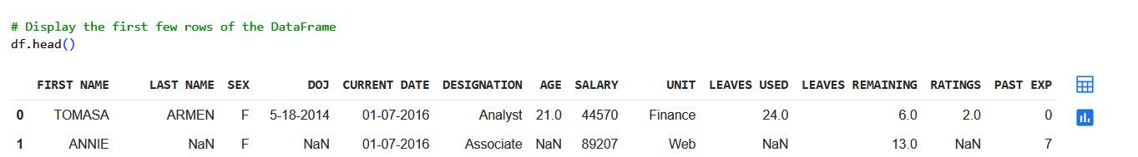
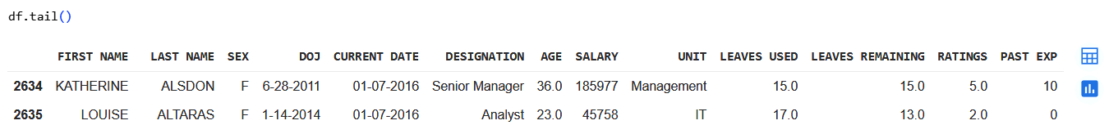
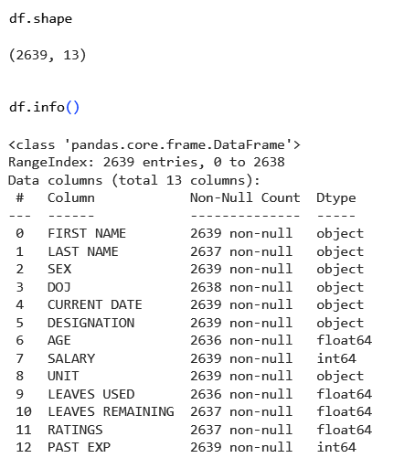
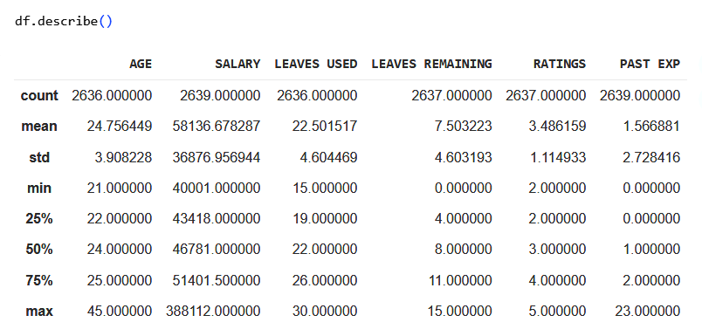
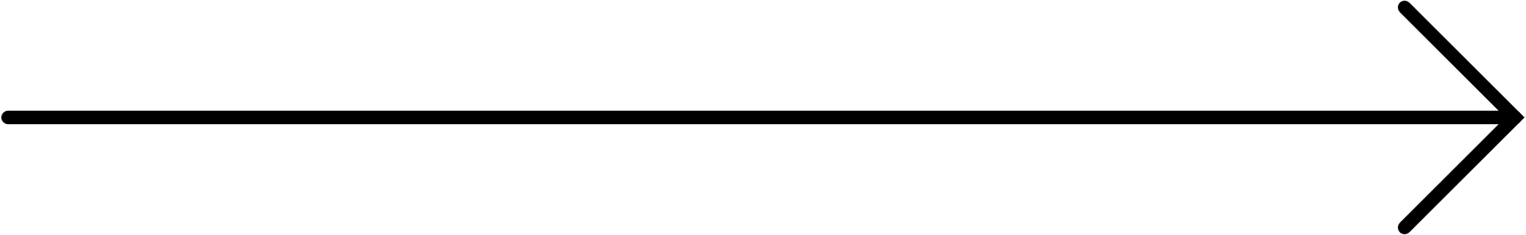

Step 1: Exploratory Data Analysis (EDA)
First few rows
Last few rows
Shape
Summary Statistics.

Slide 5

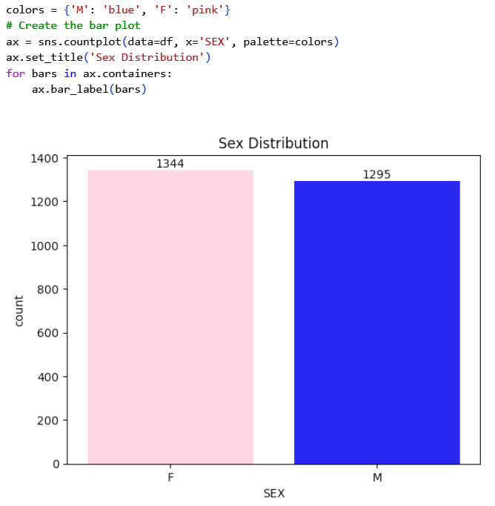
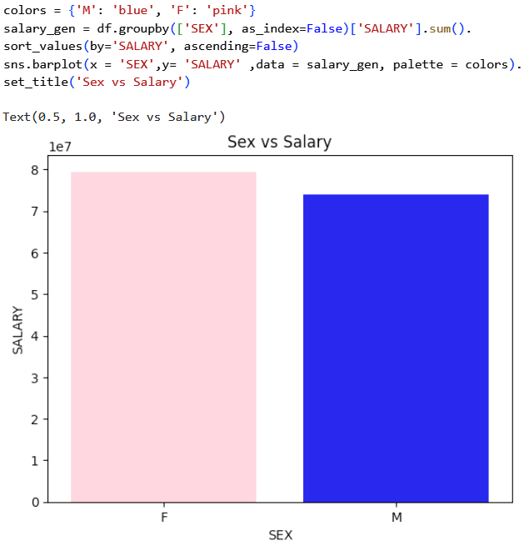
Step 2: Data Visualization
Sex Distribution
BAR CHART SHOWING SEX DISTRIBUTION
BAR CHART SHOWING SEX VS SALARY

Slide 6
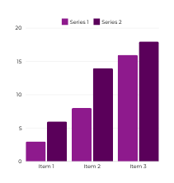
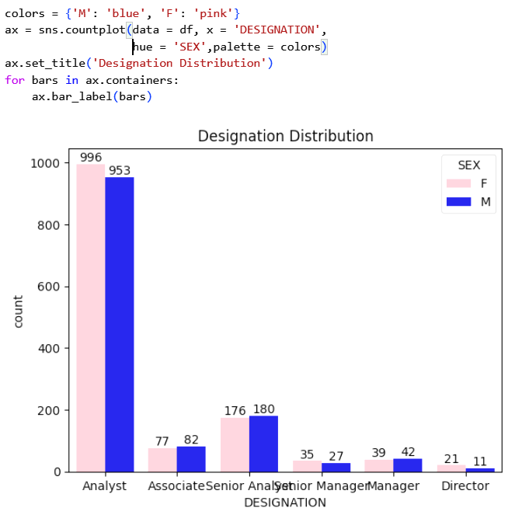
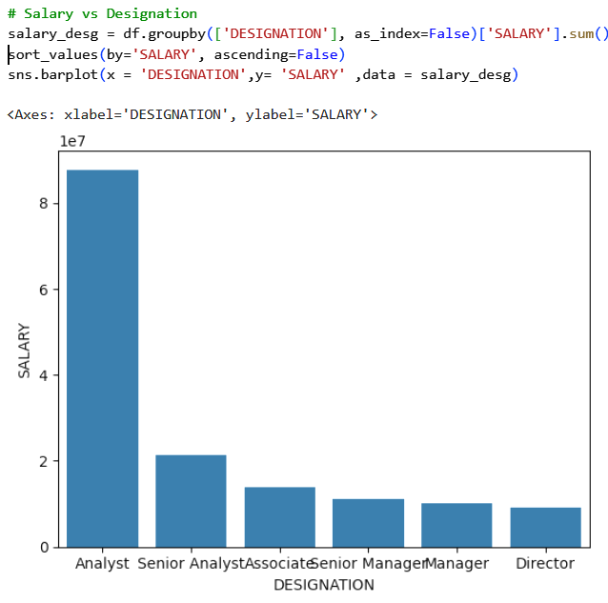
Step 2: Data Visualization
Designation Distribution
DESIGNATION DISTRIBUTION BY SEX
SALARY VS DESIGNATION

Slide 7

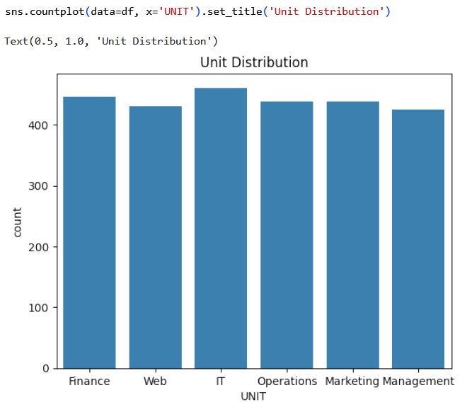
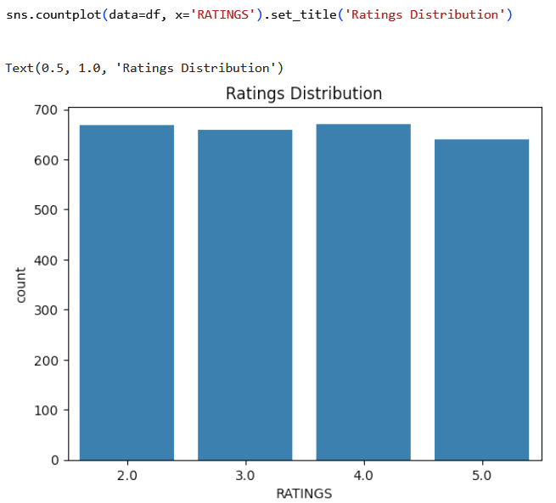
Step 2: Data Visualization
Unit Distribution
UNIT DISTRIBUTION
RATINGS DISTRIBUTION

Slide 8
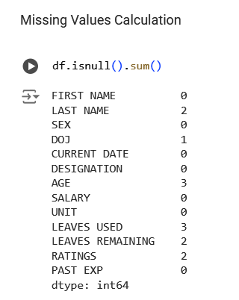
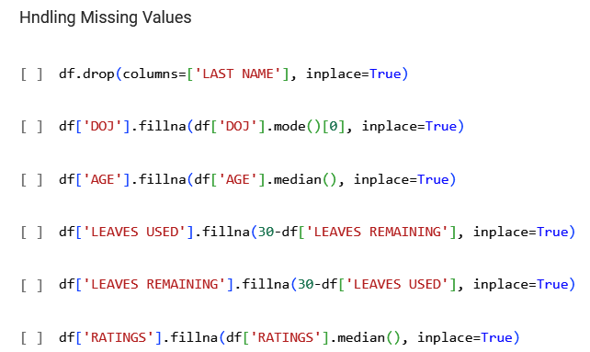
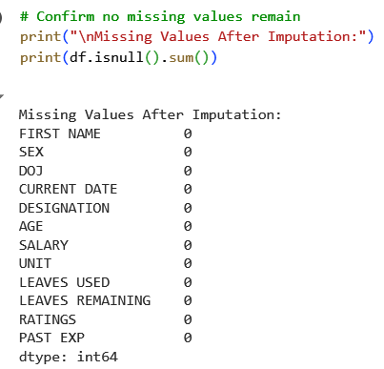

Step 3: Data Preprocessing
Filling Null Values in LAST NAME, DOJ, AGE, LEAVES USED, LEAVES REMAINING, RATINGS

Slide 9
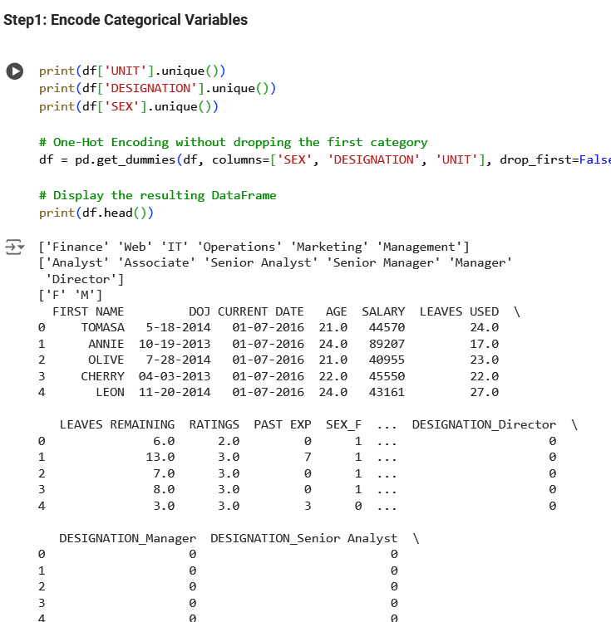
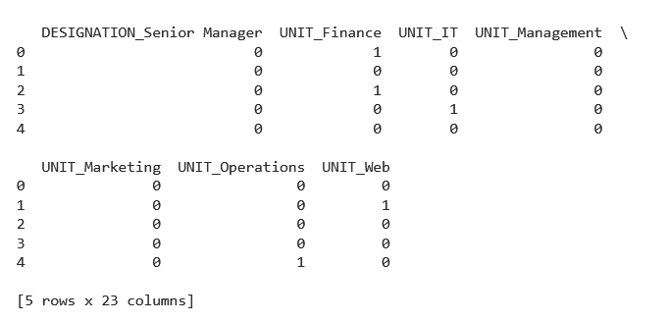
Step 3: Data Preprocessing
One-Hot Encoding: Convert categorical variables into one-hot encoding to simplify processing.

Slide 10

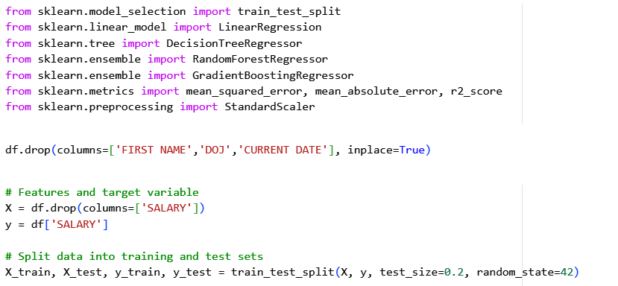
Step 4: Model Development & Evaluation
Train various regression models: Linear Regression, Decision Trees, Random Forests, Gradient Boosting and Evaluate using Metrics

Slide 11
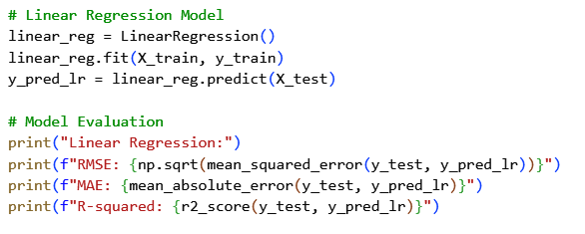

Step 4: Model Development & Evaluation
LINEAR REGRESSION

Slide 12
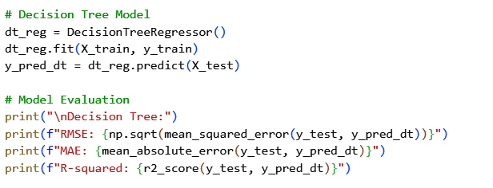

Step 4: Model Development & Evaluation
DECISION TREE

Slide 13
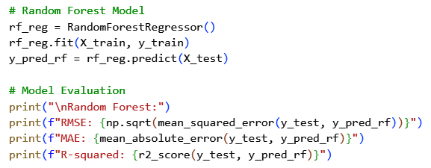

Step 4: Model Development & Evaluation
RANDOM FOREST

Slide 14
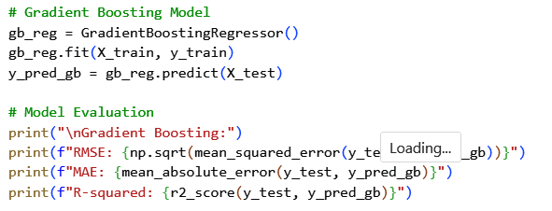
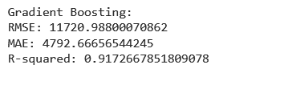
Step 4: Model Development & Evaluation
GRADIENT BOOSTING

Slide 15

Step 5: Model SELECTION
MODEL PERFORMANCE:
MODEL
RMSE
MAE
R-SQUARED
Linear Regression
9787.76
4636.4
0.942
Decision Tree Regressor
12174.38
5442.89
0.91
Random Forest Regressor
0.933
10545.03
4717.07
Gradient Boosting
11720.98
4792.66
0.917

Slide 16

Step 5: Model SELECTION
SELECTED MODEL: LINEAR REGRESSION
REASON:
This model was selected based on its superior performance across the evaluation metrics. Specifically, it achieved the lowest RMSE and MAE, along with the highest R-squared value (0.942), indicating both accuracy and reliability in predictions.

Slide 17

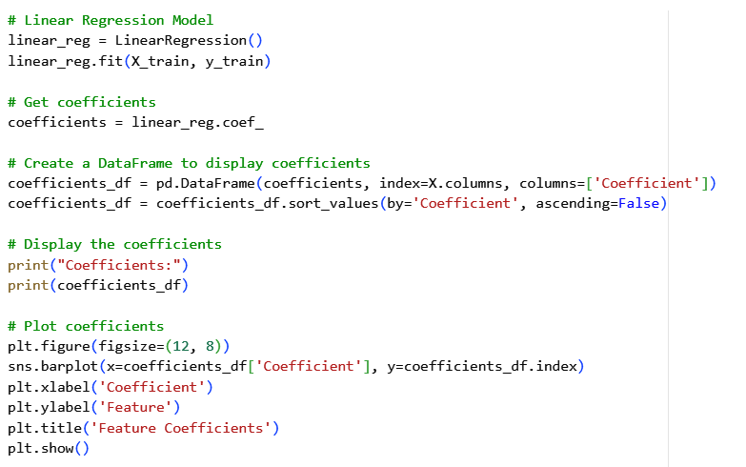
Step 6: Model Saving and Feature Importance
Model Saving
Feature Importance

Slide 18
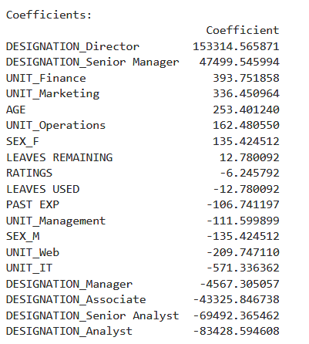
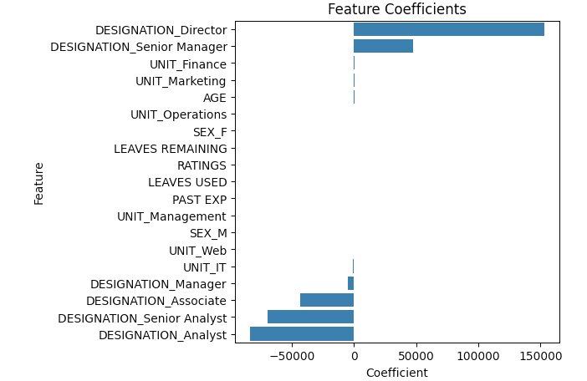
Step 6: Model Saving and Feature Importance

Slide 19
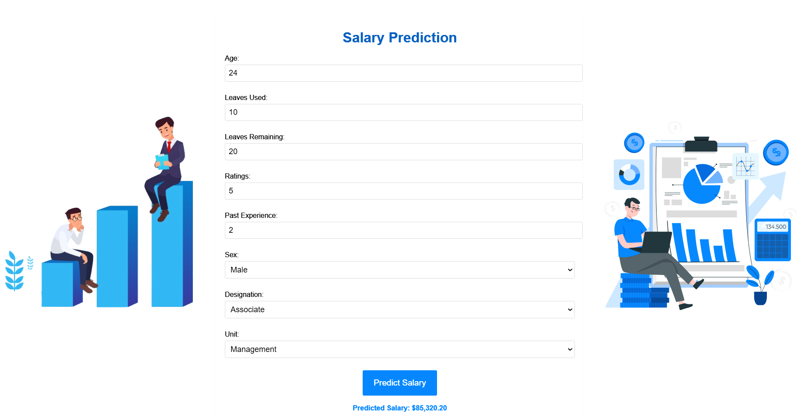
Step 7: Model Deployment

Slide 20


CONCLUSION
The Linear Regression model emerged as the best performer among the models evaluated, exhibiting the lowest RMSE and MAE, and the highest R-squared value. This indicates its superior accuracy and ability to explain variance in salary data. Features like age, past experience, and job role were found to be significant predictors of salary. Moving forward, continuous monitoring and potential feature engineering could further enhance the model's performance.

Slide 21





THANK
YOU
SONAL SONARGHARE
sonalsonarghare30@gmail.com
A.P SHAH INSTITUTE OF TECHNOLOGY

